Slide 1

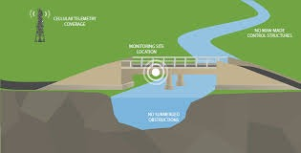
Flood Monitoring System
By Group 9
UIDs | Name
20BCS6700 | Karuna Gulati
20BCS6702 | Amanjot Singh
20BCS6704 | Shweta Arora
20BCS6731 | Aahish Aahan

Slide 2
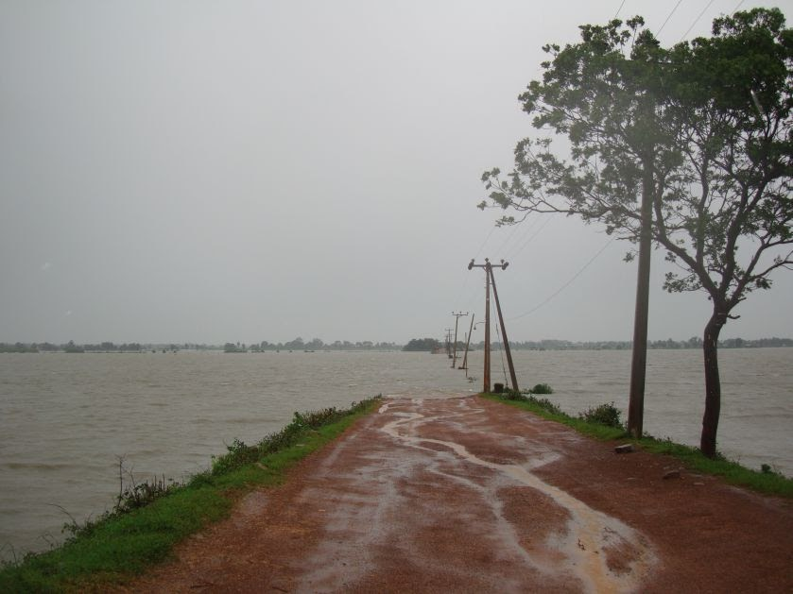
Why must floods be monitored?
Flood is a major known natural disaster that causes a huge amount of loss to the environment and living beings. So in these conditions, it is most crucial to get the emergency alerts of water level status at river beds in different conditions.
In this project, the objective is to sense the water levels at river beds and check whether they are at a normal condition or not.

Slide 3
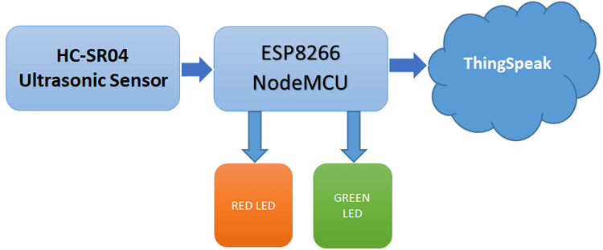
Working of IOT based Flood monitoring system
Components Required
ESP8266 NodeMCU
Ultrasonic Sensor
Power supply
LEDs(Green & Red)
Jumpers
Breadboard
Wires and resistors
The ultrasonic sensor is used to sense the water level of the river. The Data output from the ultrasonic sensor is fed to the
NodeMCU, where it is processed and sent to ThingSpeak for Graphical monitoring and Critical alert. Here, a red LED is used o alert during the critical flood conditions, and the Green LED is used to indicate the normal condition.

Slide 4
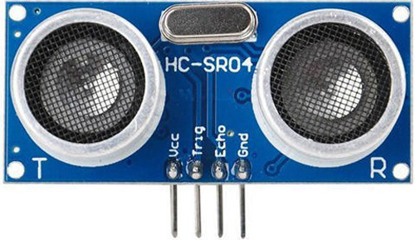
Ultrasonic Sensor
The ultrasonic sensor works on the principle of ultrasound waves which is used to determine the distance to an object. An ultrasonic sensor generates high-frequency sound waves. When this ultrasound hits the object, it reflects as
echo which is sensed by the receiver. By using the time
required for the echo to reach the receiver, we can calculate the distance to an object we are targeting.
Distance = (Time*Speed of sound in air (340m/s))/2

Slide 5
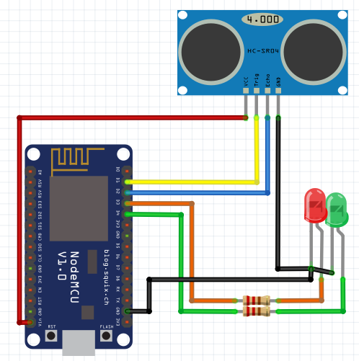
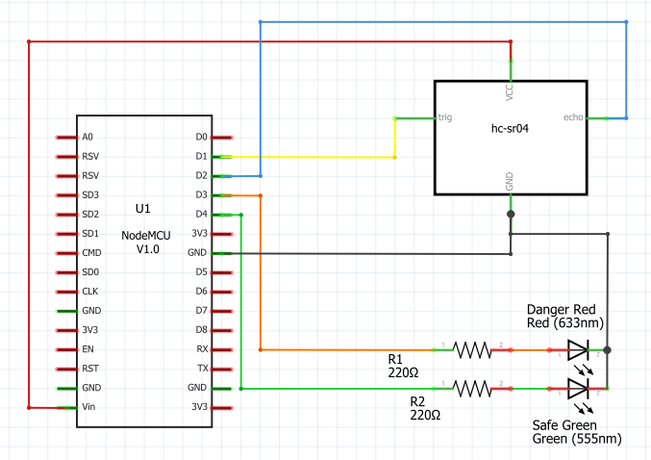
Circuit Diagram
Schematic

Slide 6
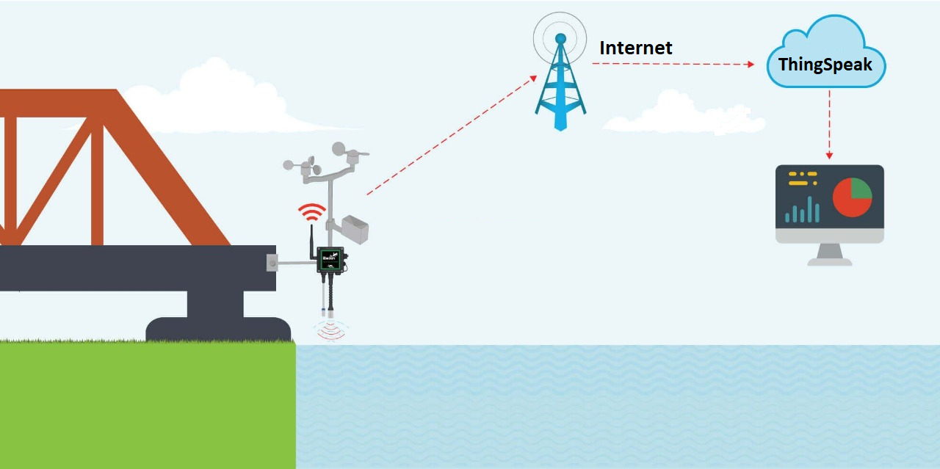

Slide 7
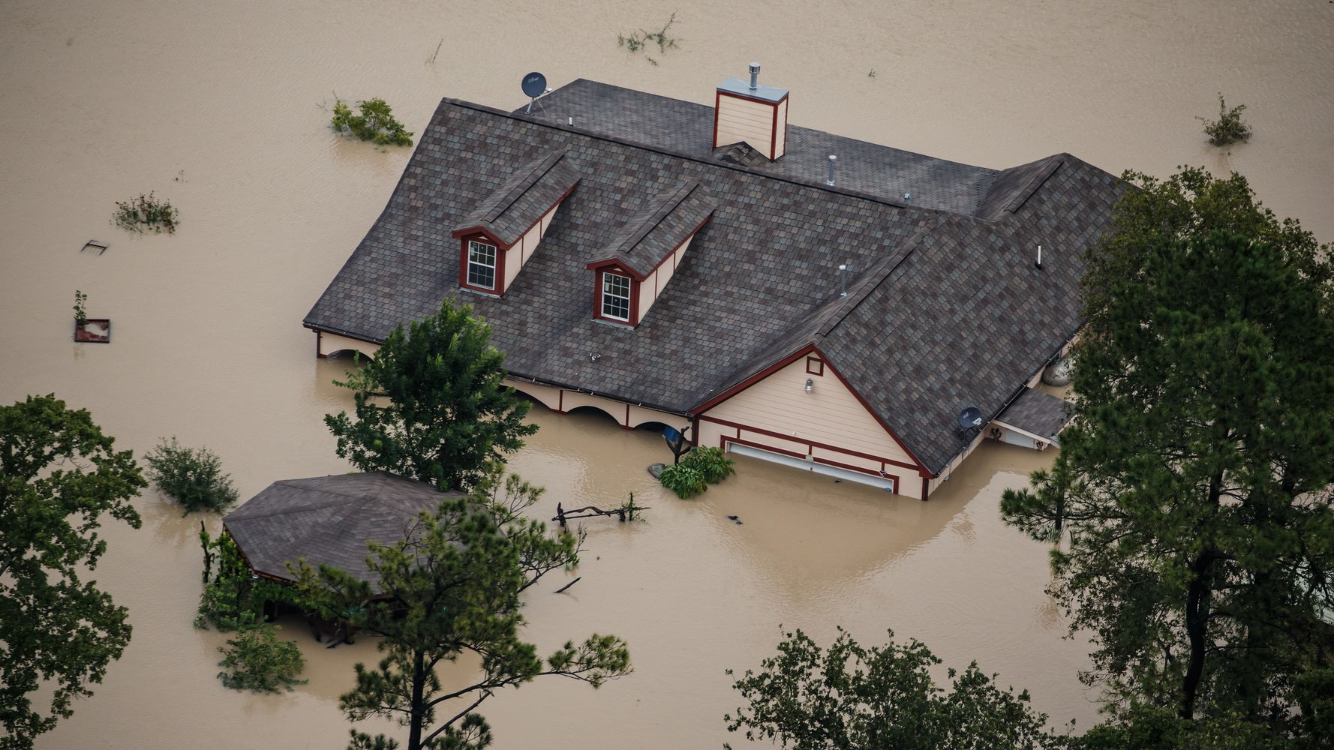
Benefits & Losses
The timely operation of flood control structures(Eg gates, temporary flood resistances) preventing inundation of property and land.
The installation of flood resilience measures(Eg sandbags, property flood barriers).
The removal of property to somewhere above the flood level or out of the flood plain.
Overall safeguard of property and lives of people.
Some people may not be able to access the warnings.
Flash floods may happen too quickly for a warning to be effective.
They do not stop land from flooding - they just warn people that a flood is likely.

Slide 8

Expansions yet to come
The ThingSpeak’s virtual platform displays us the graph of the water level data detected from the waterbody likewise it could be enhanced to monitor additional aspects like Humidity, Temperature, pressure and rain etc., to help better predict any probabilities of floods events.
And also with the led alarm system there could be quite a few buzzers added too and there could also be added a dependable system that alerts the officers of the region in the form of an SMS that there might be a flood condition incoming.

